Slide 1
Regression Project: Predicting Average Temperature Values
Sarah Mahlangu
December 2024

Slide 2
Agenda
Introduction
Data Source
Methodology
Exploratory Data Analysis (EDA)
Model Comparison
Final Model Results
Conclusion

Slide 3
Introduction
The aim of this project is to analyse and predict average temperature increase in different regions using data from the FAO and IPCC, to understand climate impacts and develop sustainable strategies for stakeholders including policymakers and agricultural businesses.
The purpose of this project is to analyze and predict average temperatures specifically in the agri-food sector.
By leveraging data from the FAO (Food and Agriculture Organization) and the IPCC (Intergovernmental Panel on Climate Change), the project aims to gain deeper insights into how climate impacts influence the agricultural industry.
The objective is to help develop sustainable strategies that can be used by policymakers and agricultural businesses to mitigate risks associated with climate change and enhance agricultural productivity and sustainability

Slide 4
Data Source
The agricultural CO2 emission dataset has been constructed by merging and reprocessing approximately a dozen individual datasets from the Food and Agriculture Organization (FAO) and data from IPCC.
These datasets were, cleaned, preprocessed and merged together to create a comprehensive and cohesive dataset for analysis and forecasting purposes.
The dataset describes CO2 emissions related to agri-food, which amount to approximately 62% of the global annual emissions. Indeed, the emissions from the agri-food sector are significant when studying climate change.
As the dataset shows, these emissions contribute to a substantial portion of the global annual emissions.
Understanding and addressing the environmental impact of the agri-food industry is crucial for mitigating climate change and developing sustainable practices within this sector.

Slide 5
Methodology
Data Cleaning
Renaming columns
Handling Nulls
Handling duplicates
Removing outliers
Data Visualisation/ Analysis
Summary statistics
Histograms
Pair plots
Correlation Matrix
Regression Models
Linear regression
Random forest regressor
Gradient boosting regressor
Evaluation
RMSE
R-squared

Slide 6
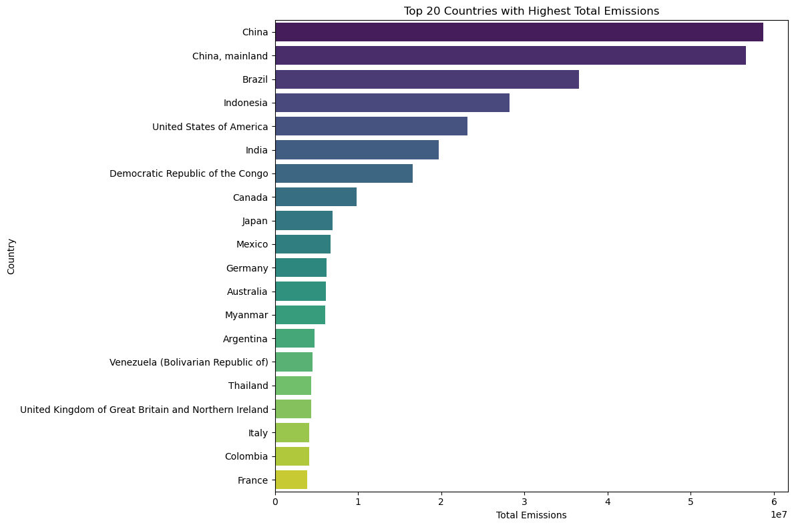
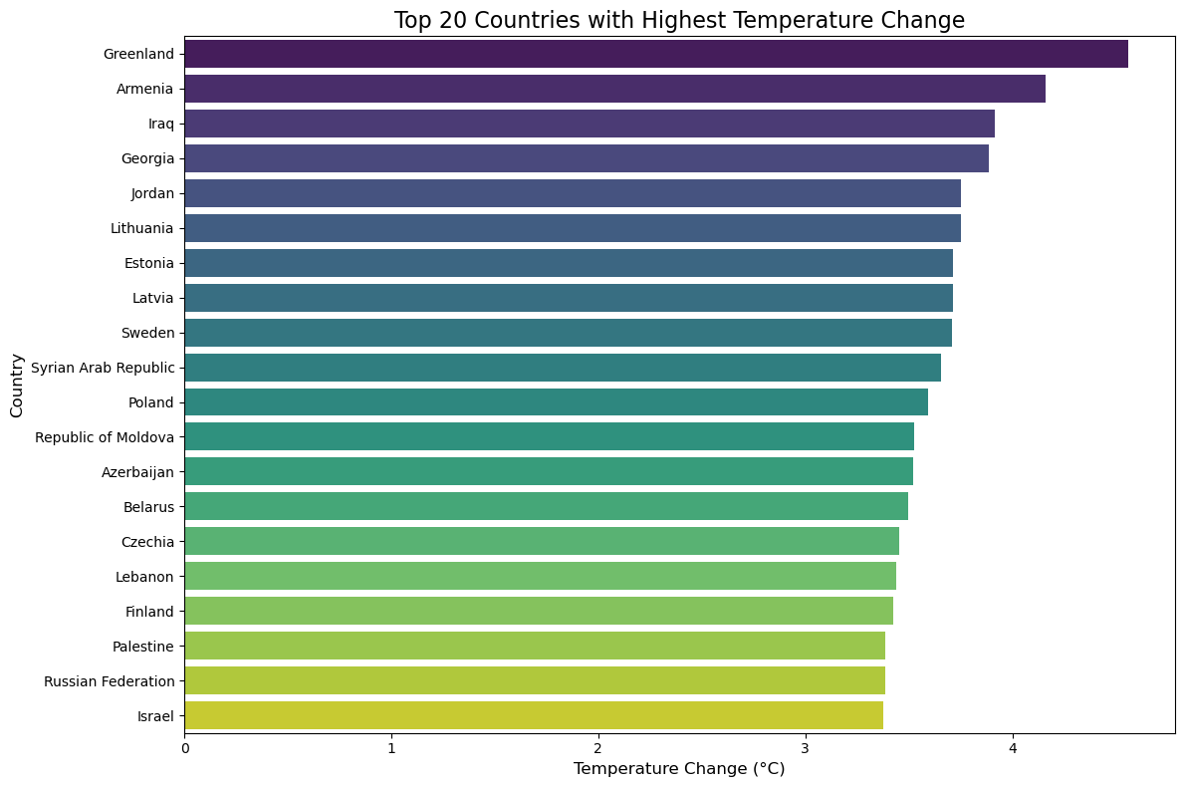
EDA
Greenland shows the highest temperature change, approaching 4°C. This is significantly higher than other countries, indicating severe climatic shifts.
Armenia, Iraq, Georgia, Jordan, and Lithuania also show considerable temperature changes, all above 2.5°C.
Greenland’s high temperature change points to the intense effects of climate change in the Arctic region, which can lead to accelerated ice melt and rising sea levels.
China stands out as the largest emitter with a significant lead over other countries.
United States of America and India are also among the top contributors, following China.
Other notable countries include Brazil, Indonesia, and Russia.
The list includes countries from various continents, indicating that emissions are a global issue. Both developed (e.g., USA, Japan, Germany) and developing countries (e.g., India, Brazil, Indonesia) are represented, reflecting different stages of industrialization and economic development.

Slide 7
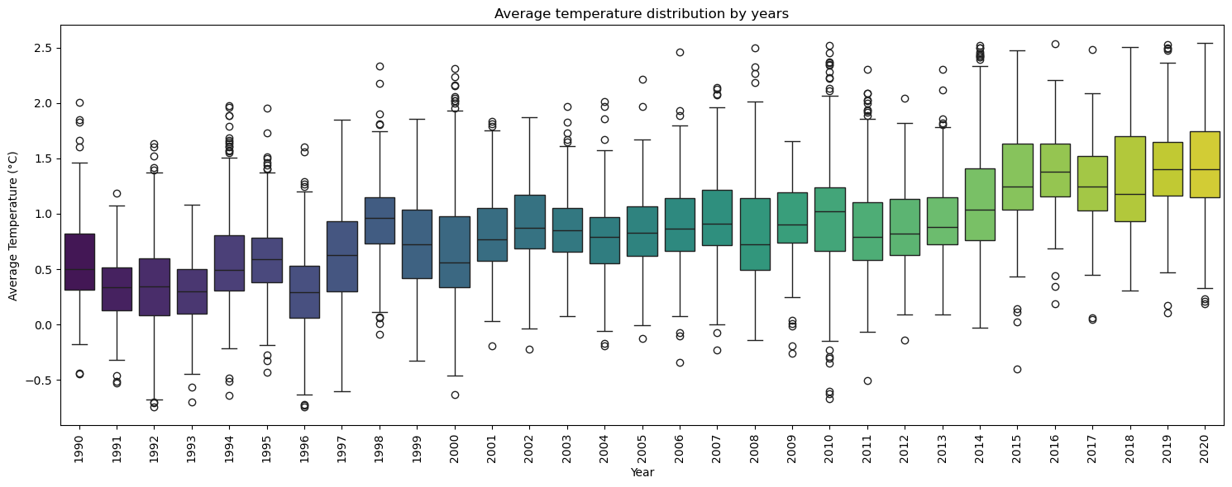
EDA
Rising Temperatures: The median temperature shows a gradual increase over the 30-year period. This suggests a warming trend, consistent with global climate change patterns.
Variability in Temperatures: The IQR and presence of outliers indicate fluctuations in temperature. Some years have higher variability, which could be due to extreme weather events or other anomalies.
Outliers: Outliers highlight years with extreme temperatures. Identifying these years can help understand specific events that caused significant deviations from the norm.

Slide 8
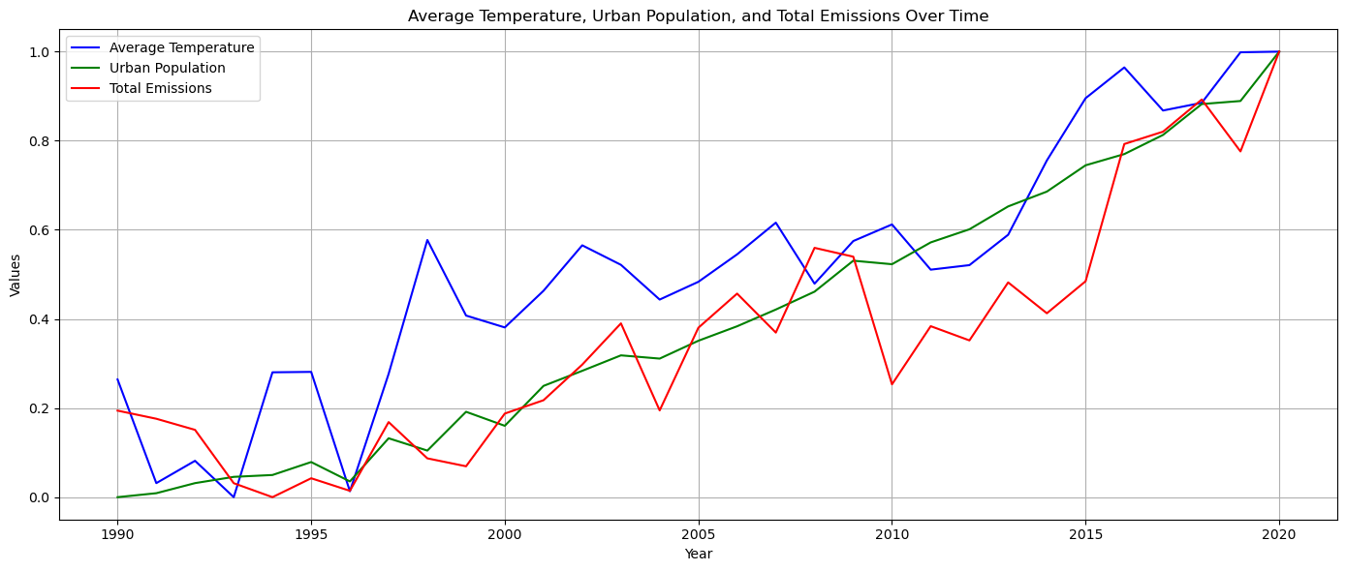
EDA
Average Temperature: Generally increasing trend over the 30-year period. This suggests a rise in average temperatures, indicative of global warming and climate change.
Urban Population: Steady and continuous increase over time. This reflects the growth of urban populations, possibly due to urbanization, economic development, and migration to cities.
Total Emissions: Increasing trend, with some variability. This indicates that total emissions have been rising, likely contributing to environmental issues such as air pollution and climate change.
Overall, there appears to be a correlation between the rise in urban population, total emissions, and average temperatures. As more people move to urban areas, the increase in emissions could be driving the rise in temperatures.

Slide 9






Model Comparison
Linear Regression Model
Random Forest Regressor:
Gradient Boosting Regressor:
- RMSE: 0.4302
- R2: 0.3533
- Performance: Poor, with significant deviations from actual
values, especially for
higher values.
- RMSE: 0.3541
- R2: 0.5619
- Performance: Good, with predictions closely following the actual values, though not perfect
- RMSE: 0.3793
- R2: 0.4973
- Performance: Moderate, with significant deviations from actual
values, especially for
higher values.

Slide 10
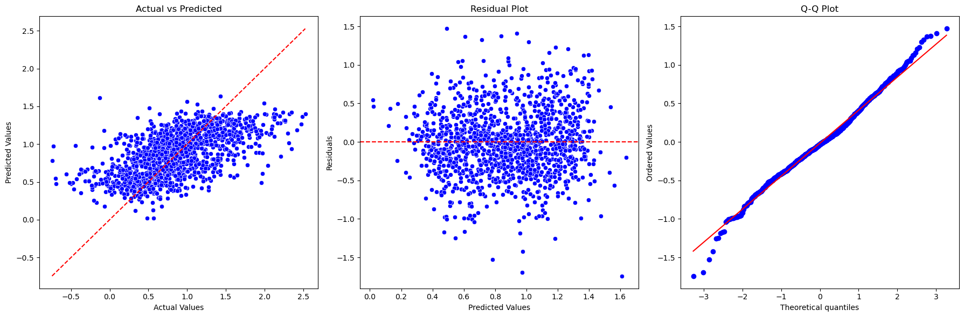
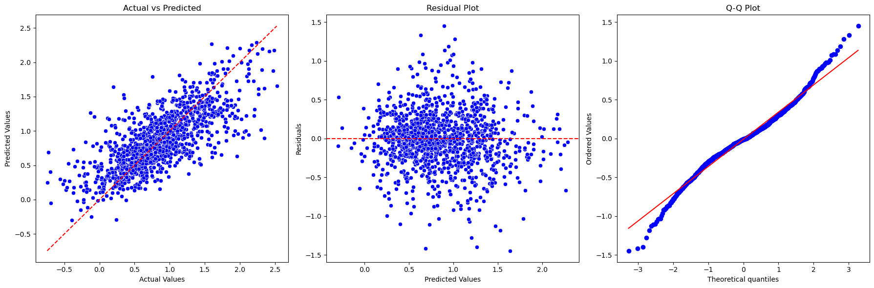
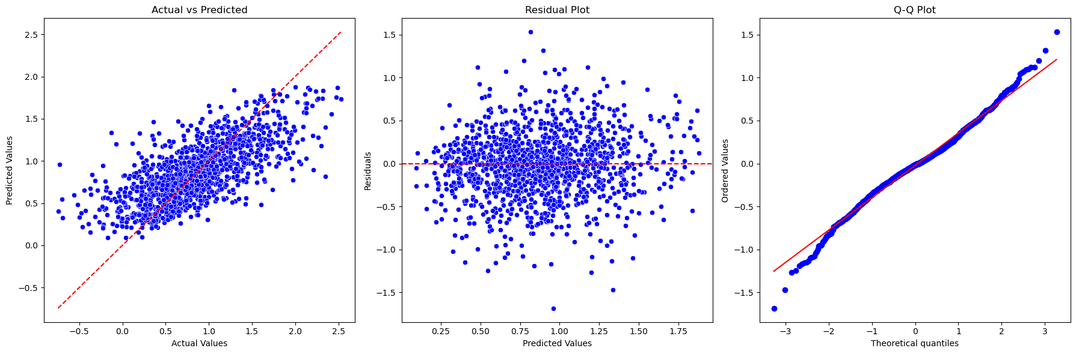
Model Comparison
Worst Model:
Linear regression, with much higher RMSE and lower R2, indicating poor predictive performance
Best Model:
Random forest regressor, with the lowest RMSE
and highest R2, indicating near- perfect predictions.
Second Best Model:
Gradient Boosting regressor, with slightly higher RMSE and lower R2 than Random forest regressor but still moderately accurate.

Slide 11
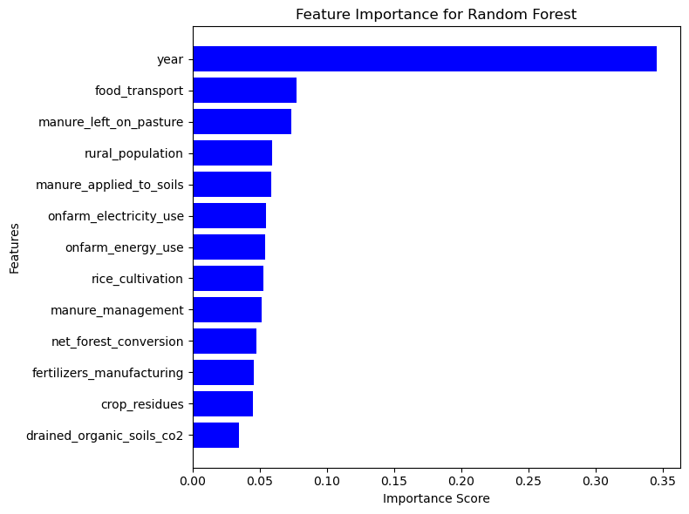
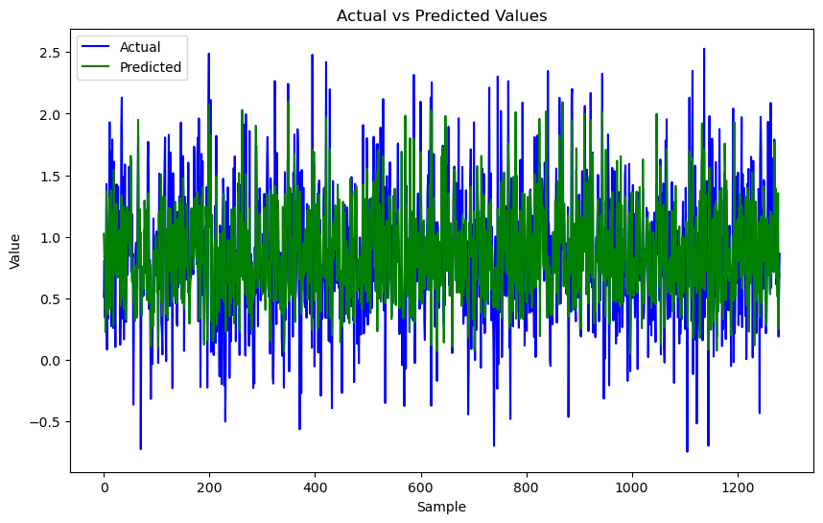
Final Model Results
The close alignment of the lines indicates high model accuracy, suggesting it effectively predicts the actual values.
The consistency in overlapping lines across the sample range implies the model performs well over different subsets of the data.
Points of deviation highlight areas where the model could be improved.
Year dominates the model's prediction, indicating that temporal changes are crucial in determining the outcomes. This might suggest that the data has strong time-related trends or patterns
.Features related to agriculture, such as manure left on pasture, manure applied to soils, and rice cultivation, also have substantial importance scores.

Slide 12
Conclusion
Random forest Regression model performed well, achieving a Mean Squared Error (MSE) of 0.366 and an R-squared (R2) score of 0.533, indicating reasonable predictions.
Gradient Boosting Regressor also demonstrated strong performance with an MSE of 0.376 and an R2 of 0.507.
Linear Regressor showed significantly poorer performance, with an MSE of 0.430 and an R2 of 0.353.
Random Forest and Gradient Boosting regressors are effective for predicting the target variable in this dataset.
Random Forest regressor can be reliably used for forecasting and planning purposes.
Future research could explore additional models and techniques, such as ensemble methods or deep learning approaches, to further improve prediction accuracy.
Additionally, investigating the impact of different feature engineering techniques and hyperparameter tuning could yield better results.

